Slide 1

What are Tensegrity Structures ?
Tensegrity (Tension + Integrity)
“Structures that gain their integrity and stability through tensional forces rather than pure compression.”
Tension
Consists of struts (compression members) and cables (tension members)
Struts and cables are in equilibrium which keeps the structure stable

Slide 2
An FE Model of a cell using tensegrity structures
Microfilaments
Microtubules
Microtubules
Nucleus
Nucleus
Interfilament
Microfilament
Interfilament
Focal adhesion
Focal Adhesions
A cancer cell
https://www.scientificamerican.com/gallery/a-stunning-3-d-journey-inside-a-cancer-cell/
A Tensegrity model of a cancer cell in MATLAB
A Computational FE Cell Model which accounts for Cytoskeletal mechanics
Models the salient features of cell such as Cytoskeleton filaments, Intermediate filaments, focal adhesions, etc
Considers the presence and influence of prestress in the cell
Potential to capture many essential mechanics of a cell

Slide 3
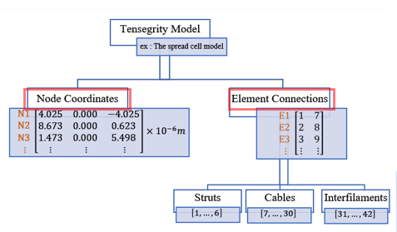
What the codes can Do - 1
n = 3
Generate and display commonly used tensegrity structures
basic form finding - to create other valid (structurally stable) tensegrity structures
FEM analysis of the tensegrity models
n = 4
n = 5
Constituents of a tensegrity model in MATLAB
prismatic tensegrity structures
6 strut
spherical tensegrity
12 strut
spherical tensegrity
30 strut
spherical tensegrity
Spherical Tensegrity Structures

Slide 4
What the codes can Do - 2
Generate a numerous configurations of cell models using spherical tensegrities
6 strut spherical tensegrity
12 strut spherical tensegrity
30 strut spherical tensegrity
Different cell models using combinations of spherical tensegrities

Slide 5
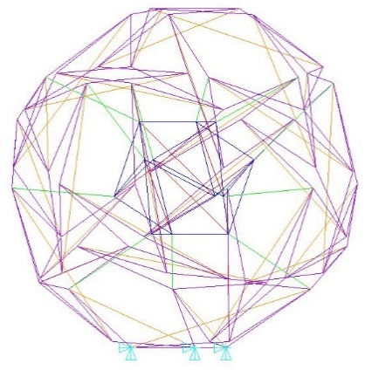
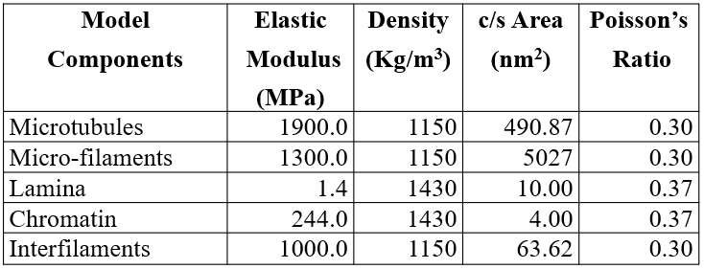
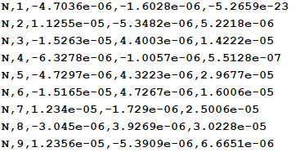
What the codes can Do - 3
Auto generate Ansys APDL Macro codes to help build an FEM model of a cell for dynamic analysis
Link 180 elements
Tension only condition
Prestress
Material properties:
Auto Generate APDL Codes
MATLAB function:
APDL_print_coord()
Boundary Condition
Tensegrity model of a cell
FEM model of cell in Ansys APDL

